Slide 1
Goal-Based Framework for Software Measurement
Chapter 3

Slide 2
Classifying Software Measure
The first obligation of any software measurement activity is to identify the entities and attributes that we want to measure. Software entities can be classified as follows:
Processes: Software-related activities
Products: Artifacts, deliverables, or documents that result from a process activity
Resources: Entities required by a process activity
Within Each class of entity, we distinguish between the internal and external attributes of a product, process, or resource:
Internal attributes: Attributes can be measured purely in terms of process, product, or resource itself (e.g., size)
External attributes: Measured based on the behaviors of the entities (e.g., quality)

Slide 3
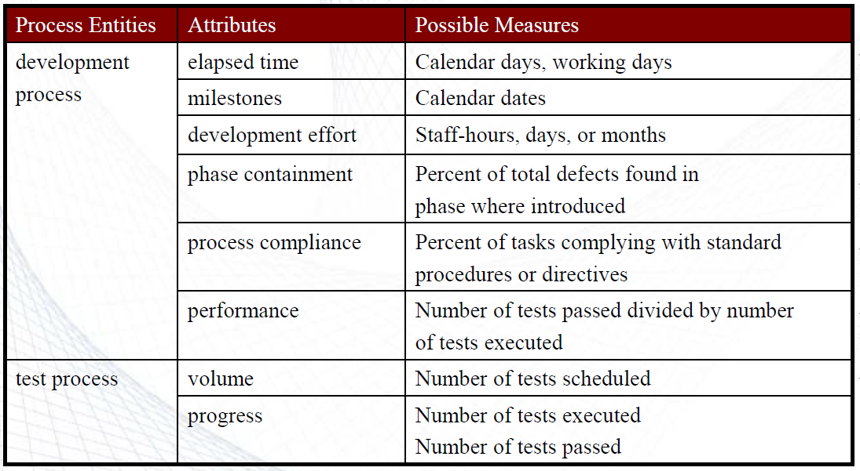
Sample Process Measures/1
* Phase containment refers to the practice of detecting and fixing defects (bugs or problems) in the same phase where they are introduced rather than letting them progress to later phases.

Slide 4
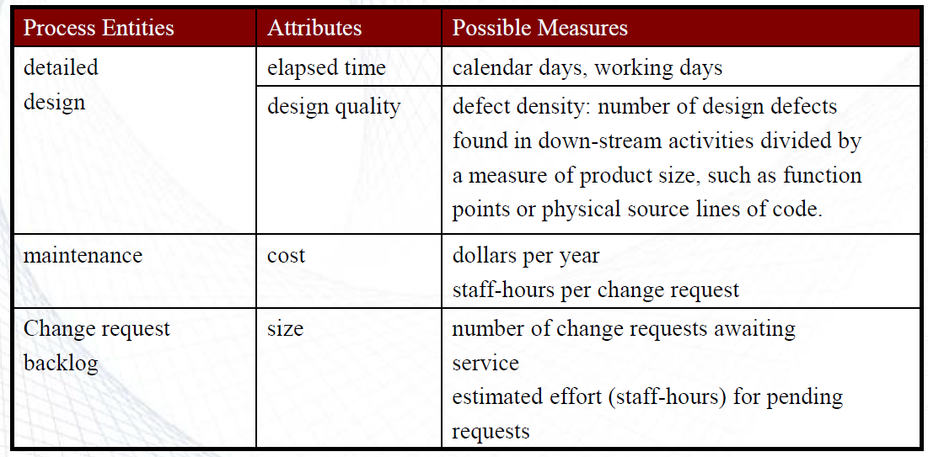
Sample Process Measures/2

Slide 5
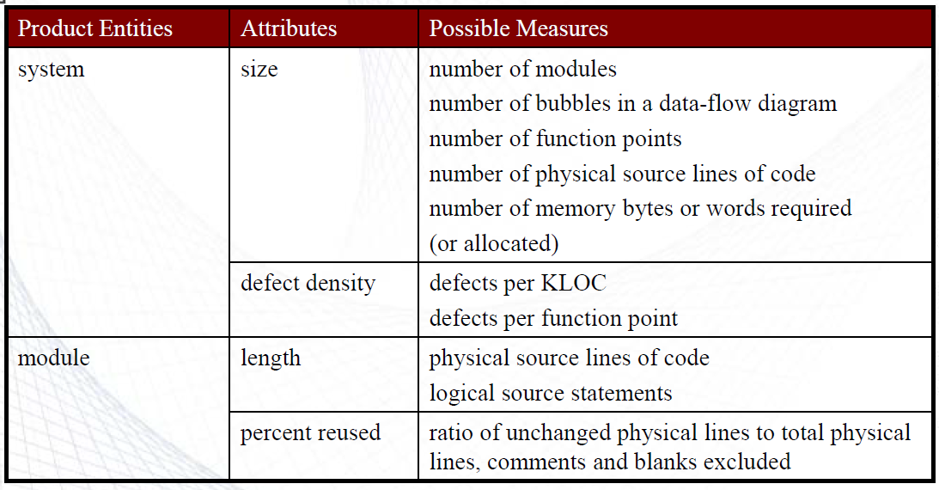
Sample Product Measures/1

Slide 6
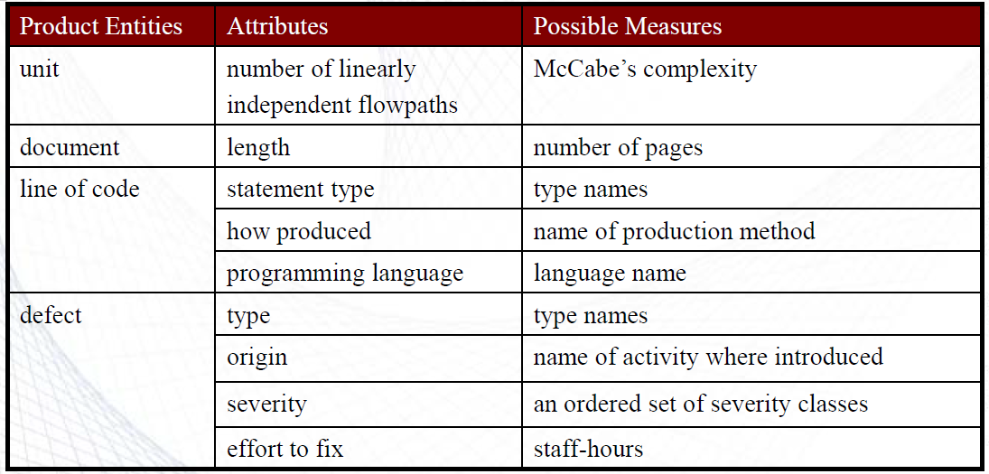
Sample Product Measures/2

Slide 7
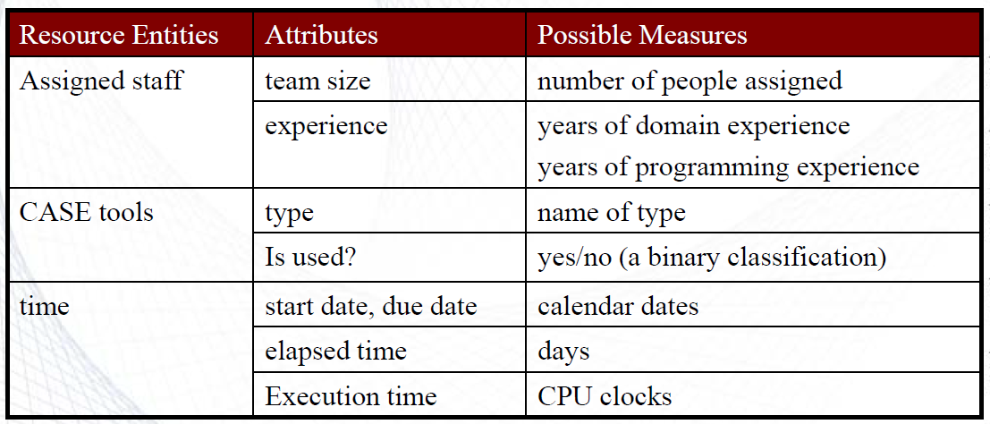
Sample Resource Measure

Slide 8
Goal-Question-Metric Paradigm
The Goal-Question-Metric (GQM) Paradigm is a structured approach used in software engineering to define and measure goals effectively. When goal is defined clearly, important and meaningful metrics can be identified effectively.
The GQM framework is mainly divided into three major steps
Goal: List the major goals of the development or maintenance project
Question: Derived from each goal the question that must be answered to determine whether the goals are being met
Metrics: Decide what must be measured in order to be able to answer the questions adequately
For example,
Goal: Improve code quality
Question: How many defects are found in code reviews? How often is refactoring needed?
Metric: Number of defects per review, frequency of refactoring.

Slide 9
Measurement Goal
A measurement goal is a specific objective that guides what needs to be measured within a project or process to assess its effectiveness, performance, or quality.
In software engineering, measurement goals are essential for determining what data should be collected to evaluate progress, identify issues, and drive improvements.
A proper goal may contain 3 different components:
A purpose
A perspective
A description of the environment and constraints

Slide 10
Template for Goal Definition
It is important that the goals and questions are understood in terms of their audience, e.g, a productivity goal for a project manager may be different from that for a department manager or corporate director.
Purpose: To (characterize, evaluate, predict, motivate, etc.) the (process, product, model, metric, etc.) in order to (understand, assess, manage, engineer, learn, improve, etc.) it.
Example: To evaluate the maintenance process in order to improve it.
Perspective: Examine the (cost, effectiveness, correctness, defects, changes, product measures, etc.) from the viewpoint of the (developer, manager, customer, etc.)
Example: Examine the cost from the viewpoint of the manager.
Environment: The environment consists of the following: process factors, people factors, problem factors, methods, tools, constraints, etc.
Example: The maintenance staff consists of poorly motivated programmers who have limited access to tools

Slide 11
Active and Passive Goals
Active goals involve purposefully collecting data through specific actions, interventions, or tests. Active goals are useful when specific data is needed to answer precise questions about the software’s behavior, performance, or reliability under controlled conditions.
Passive measurement goals are meant to enable learning or understanding. Passive goals involve collecting data as it naturally occurs without intervening in or modifying the software's operation. Passive goals are helpful for understanding real-world behavior, patterns, or issues within the software as it is used in its typical environment.

Slide 12
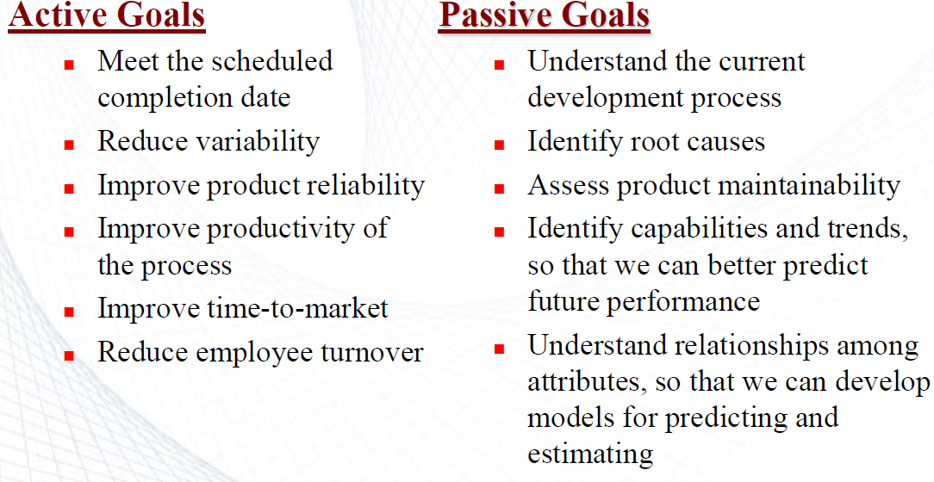
Example

Slide 13
GQM: Example/1

Slide 14
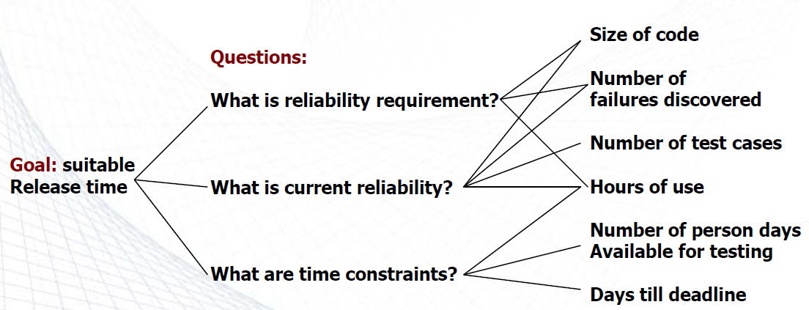
GQM: Example/2
You are a manager of a software development team and you have to decide the release time of your product. Construct a GQM tree related to this goal.

Slide 15
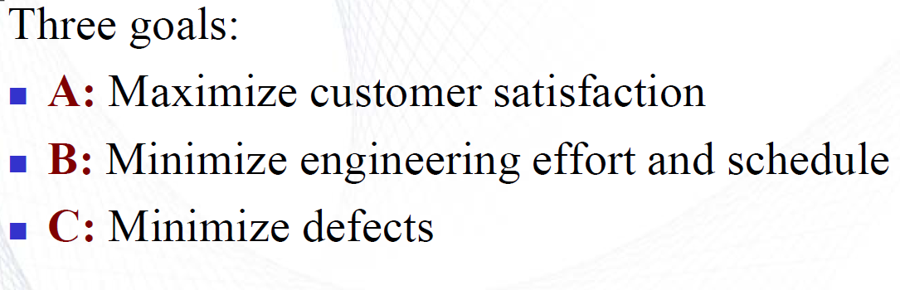
A GQM Case Study Example

Slide 16
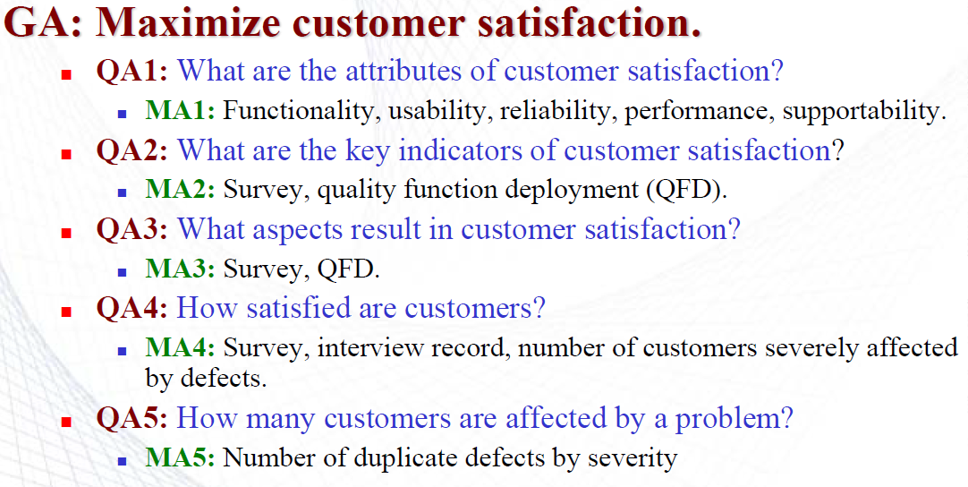
Example (Cont..)

Slide 17
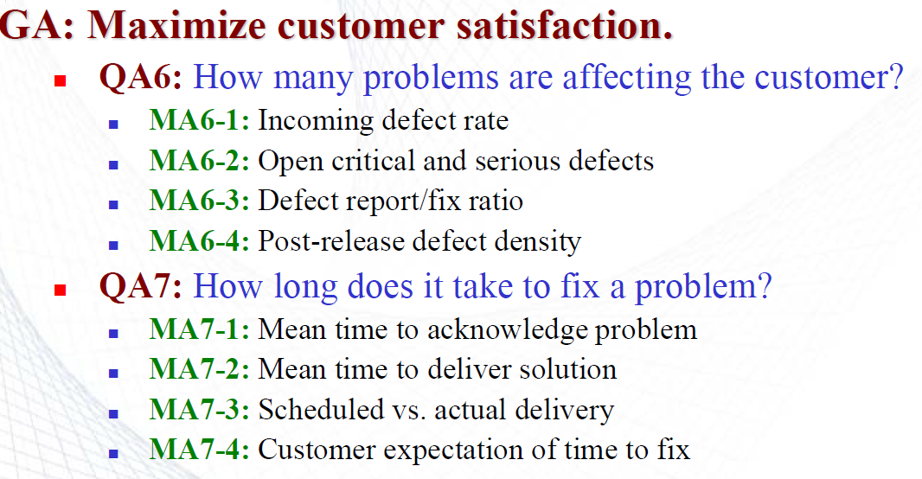
Example (Cont..)

Slide 18
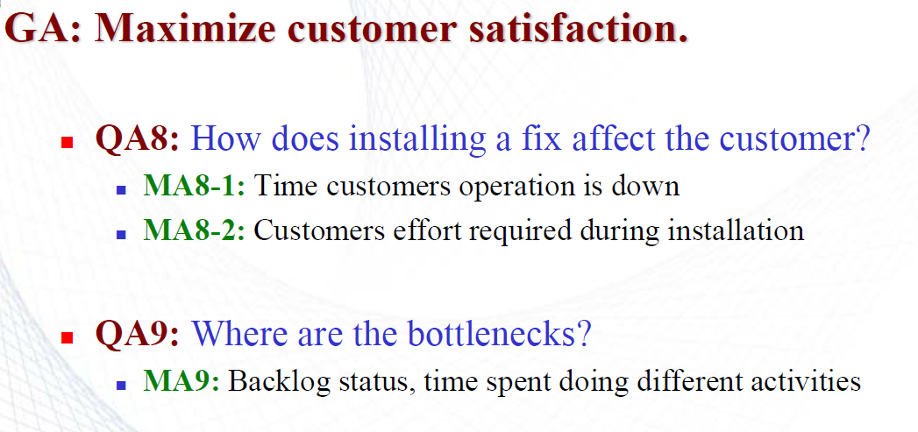
Example (Cont..)

Slide 19
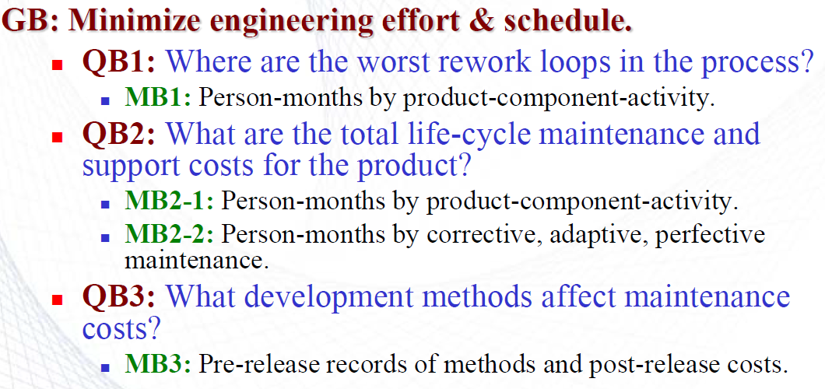
Example (Cont..)

Slide 20
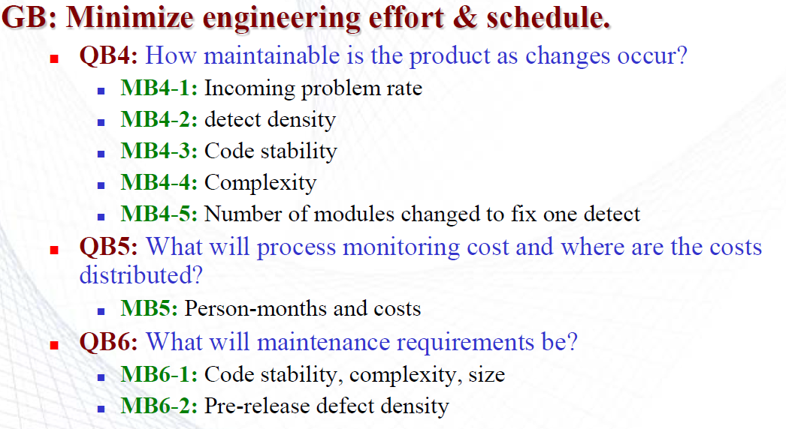
Example (Cont..)

Slide 21
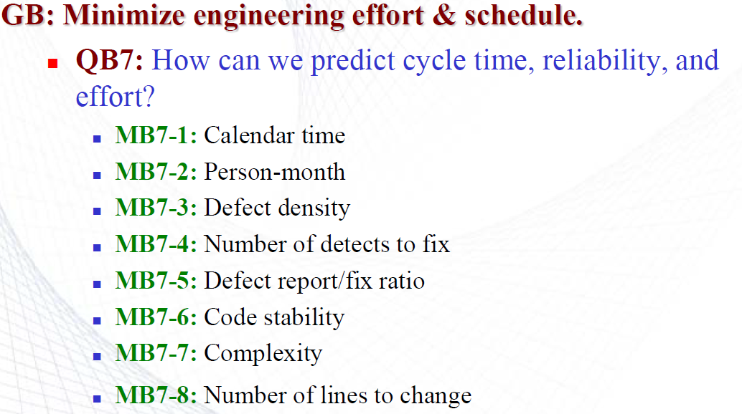
Example (Cont..)

Slide 22
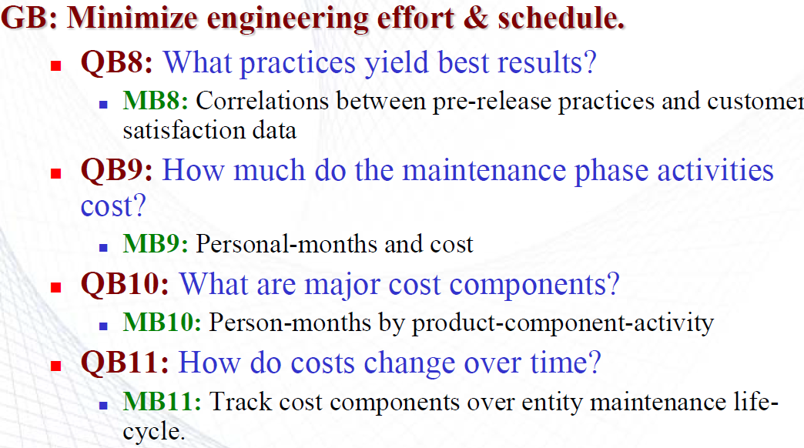
Example (Cont..)

Slide 23
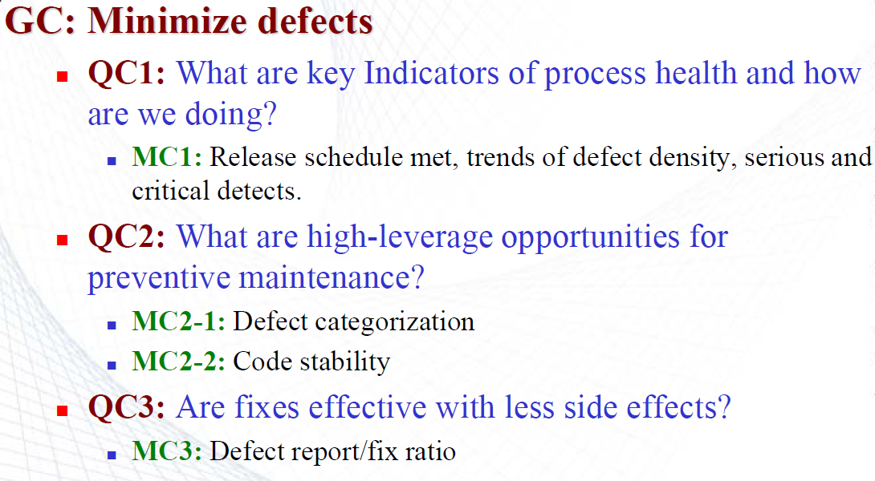
Example (Cont..)

Slide 24
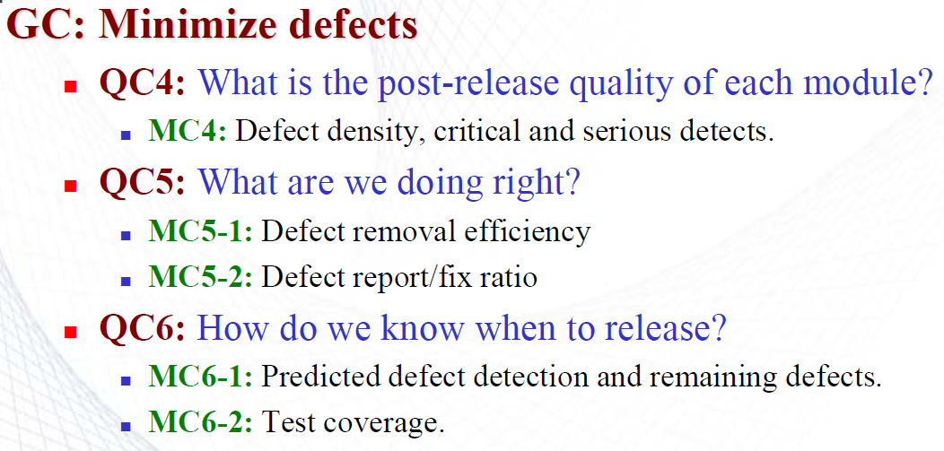
Example (Cont..)

Slide 25
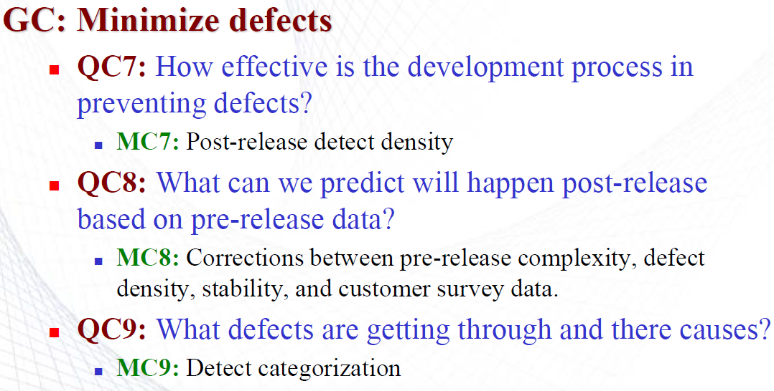
Example (Cont..)

Slide 26
Measurement for Process Improvement
One common goal in the software industry is a process improvement
Software processes can range from a chaotic and ad hoc, to well-defined and well managed
A more mature process is more likely to develop software that is reliable, adaptable, delivered on time, and within budget.
Thus measurement of processes is important to evaluate an organization or company
The Capability Maturity Model Integration (CMMI) is a popular process evaluation technique by the Software Engineering Institution (SEI)

Slide 27
Capability Maturity Model Integration (CMMI)
CMMI (Capability Maturity Model Integration) is a proven industry framework
It uses 5 levels to describe the maturity of the organization.
CMMI was initially created by the Software Engineering Institute (SEI) at Carnegie Mellon University (CMU) for use by the U.S. Department of Defense (DoD) to assess the quality and capability of their software contractors.
In the Capability Maturity Model Integration (CMMI), "process" refers to an organization's set of practices and procedures to ensure consistent, high-quality product or service development outcomes.
The CMMI maturity score, or maturity level, indicates an organization’s level of process standardization, management, and improvement capabilities.

Slide 28
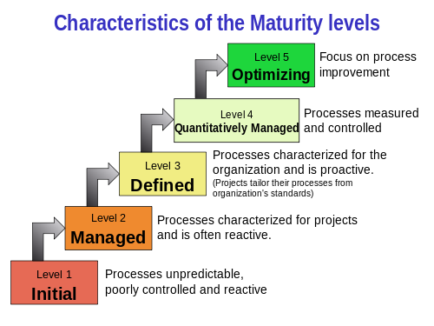
CMMI
The higher the level of maturity, the more effective the organization is

Slide 29
CMMI Model – Maturity Levels:
Maturity level 1: Initial (Ad-Hoc Project Management)
Processes are poorly managed.
Unpredictable outcomes of processes involved.
Ad hoc and chaotic approaches used.
Characterized by a tendency to over-commit, abandon processes in times of crisis, and not be able to repeat their past successes.
Reactive

Slide 30
CMMI Model – Maturity Levels:
Maturity level 2: Managed (Basic Project Management)
Requirements are managed and documented sufficiently.
Processes are characterized by projects. Planned and executed at the project level. Processes may rely heavily on individual project teams
Projects are performed and managed according to their documented plans.
The risk involved is lower than the Initial level. However, repeatability and sustainability have not yet been achieved
Often reactive.

Slide 31
CMMI Model – Maturity Levels:
Maturity level 3: Defined (Process Standardization)
Processes are well characterized and understood for all projects.
Processes, standards, procedures, methods, and tools are defined at the organization level. Some degree of process improvement occurs over time
Medium quality and medium risk are involved.
The focus is process standardization.
Organizations at this level provide training programs to ensure team members understand the standard processes and know how to implement them in their work.
Level 3 organizations create and maintain a repository of process assets, such as templates, guidelines, checklists, and other resources, which can be reused across projects.
Proactive

Slide 32
CMMI Model – Maturity Levels :
Maturity level 4: Quantitatively managed
Processes are controlled using statistical and other quantitative techniques and are quantitatively predictable (e.g., the use of the COCOMO model, FP model or other quantitative/statistical frameworks for estimation)
Moreover, the organization uses data to effectively manage risks, make processes more efficient, and correct process deficiencies. i.e., the business is ahead of risks, with more data-driven insight.
Quantitative objectives are based on data from customer requirements, organization needs, and previously developed successful projects.
Higher quality of processes is achieved.
Lower risk

Slide 33
CMMI Model – Maturity Levels :
Maturity level 5: Optimizing (Continuous Process Improvement)
Processes are stable and flexible
The organizational focus is on continuous/incremental improvement and innovative technological changes.
The highest quality of processes.
The lowest risk in processes and their performance.
Proactive and Innovative
Defect Prevention: Root cause analysis (RCA) is a common practice at Level 5
Competitive Advantage: By fostering innovation and adapting to change quickly, Level 5 organizations stay ahead of the competition.

Slide 34
Measurement for Process Improvement
REF: Mario, H. I. R. Z. "An approach supporting integrated modeling and design of complex mechatronics products by the example of automotive applications." (2018).

Slide 35
Measurement for Process Improvement
The SEI CMMI distinguishes one level from another in terms of key process activities going on at each level.
Specific goals, questions, and metrics are developed to assess whether an organization has reached a particular level.
Please see page number 106 in the referenced book.

Slide 36
Combining GQM with Process Maturity
Suppose you are using the Goal-Question-Metric paradigm to decide what your project should measure. You may have identified at least one of the following high-level goals:
Improving productivity
Improving quality
Reducing risk
Within each category, you can represent the goal’s satisfaction as a set of subgoals
For example, the goal of improving productivity can be interpreted as several subgoals affecting resources:
Assuring adequate staff skills
Assuring adequate managerial skills
Assuring adequate host software engineering technology

Slide 37
Combining GQM with Process Maturity
if you have chosen improving quality with a sub goal of improving the quality of the requirements, then the related questions might include:
Is the set of requirements clear and understandable?
Is the set of requirements testable?
Is the set of requirements reusable? etc.
Now, suppose you want to answer the question: Is the set of requirements maintainable?

Slide 38
Combining GQM with Process Maturity
Level 1, then the project is likely to have ill-defined requirements. Measuring requirements characteristics is difficult at this level, so you may choose to count the number of requirements and changes to those requirements to establish a baseline
Level 2: the requirements are well defined you can collect additional information: the type of each requirement (database requirements, interface requirements, performance requirements, etc.) and the number of changes to each type.
Level 3: your visibility into the process is improved, and intermediate activities are defined, with entry and exit criteria for each activity. For this level, you can collect a richer type of measurement: e.g. - traceability

Slide 39
Combining GQM with Process Maturity
CMMI provides a roadmap for improving process maturity, while GQM offers a structured approach to measure and evaluate progress toward that roadmap.
By using GQM within the CMMI framework:
Organizations gain clarity on what to measure at each level.
They can track the effectiveness of their processes through relevant metrics.
The two together ensure that process improvements are aligned with strategic goals.

